Slide 1
Dynamic Memory

Slide 2
Agenda
Pointers
Iterators
Dynamic Memory

Slide 3
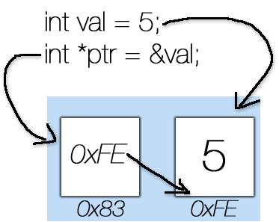
Pointers
A pointer is a variable that stores the memory address of an variable

Slide 4
Pointers
Pointers are useful for some purposes:
Allocate dynamic memory in heap
Iterate over containers or data structures (STLs Iterators)
Flexibility with implementing objects like nodes in graphs or linked lists
Direct access for data in memory without caring about its physical address

Slide 5
Pointers
Declare a pointer int *ptr ;
Declare multiple pointers int *ptr1, *ptr2 ;
Assign to a pointer ptr=&val;
Declare a pointer with initialization
int val=5;
int *ptr=&val;

Slide 6
Pointers
Address-of / Reference operator (&) :It gives the address of a variable
Dereference operator (*) : It gives the values of an address
int main(){
int val=5;
int *ptr=&val;
(*ptr)++;
cout<<val<<'\n';
cout<<&val<<'\n';
cout<<ptr<<'\n';
cout<<*ptr<<'\n';
cout<<&ptr<<'\n';
}
—> 6
—> 0x7fffffffd93c
—> 0x7fffffffd93c
—> 6
—> 0x7fffffffd940

Slide 7
Iterators
An Iterator is an abject pointing to some element in a range of elements (container), has the ability to iterate through the elements of that range.
Iterators are commonly used with STLs. why?
The C++ Standard Library containers all provide iterators so that algorithms can access their elements in a standard way without having to be concerned with the type of container the elements are stored in

Slide 8
Iterators
Iterators is provided with each container in STLs with different properties
To define an iterator for a specific container:
set<int> st={5,1,2};
set<int>::iterator it=st.begin();
it++;
cout<<*it<<'\n'; —> 2
vector<int> vec{ 2,8,6,3,4 };
vector<int>::iterator it;
it=vec.end();
it-=2;
cout<<*it<<'\n'; —> 3

Slide 9
Iterators
Iterators can be used to iterate over the elements of a container
vector<int> vec{ 2,8,6,3,4 };
for(vector<int>::iterator it=vec.begin(); it!=vec.end(); it++)
cout<<*it<<' ';
cout<<'\n';
for(auto val : vec)
cout<<val<<' ';
cout<<'\n';
for(auto& val : vec)
cout<<val<<' ';
cout<<'\n';

Slide 10
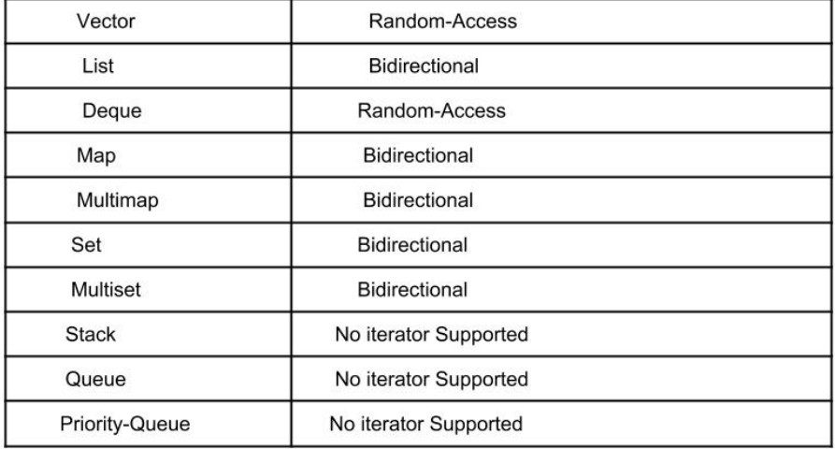
STLs Iterators

Slide 11
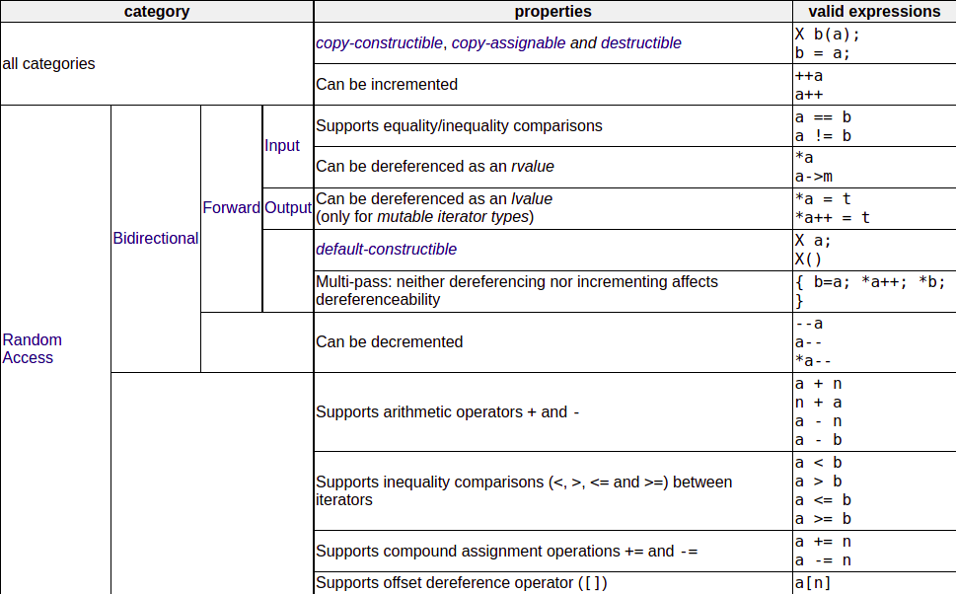
Types of Iterators

Slide 12
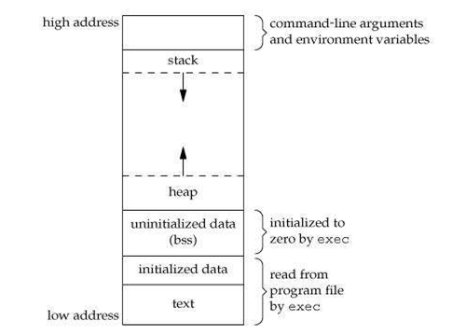
Dynamic Memory
Memory in your C++ program is divided into two parts:
The stack − All variables declared inside the function will take up memory from the stack.
The heap − This is unused memory of the program and can be used to allocate the memory dynamically when program runs.

Slide 13
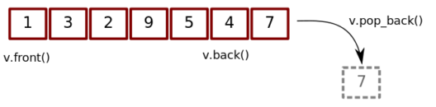
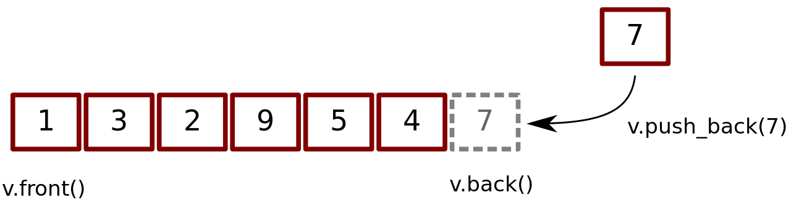
Dynamic Memory
Dynamic memory is the memory which is created during runtime. For example, when the memory needed depends on user input.
STL containers use dynamic allocations, by which, these containers can reserve (allocate) and free (deallocate) elements during runtime

Slide 14
Dynamic Memory
int main () {
int* ptrInt = NULL; // Pointer initialized with null
ptrInt = new int; // Request memory for the variable
*ptrInt = 6; // Store value at allocated address
(*ptrInt) *=2;
cout << "Value of the dynamic int : " << *ptrInt << endl;
delete ptrInt; // free up the memory
}

Slide 15
For more
For more about pointers, check this: pointers - C++ Ref
For more about Iterators, check this: iterator - C++ Ref
For more about dynamic memory, check this: dynamic memory - C++ Ref

Slide 16
To Solve
Pointers in C
Insert a node at a specific position in a linked list
Delete a Node
Reverse a linked list
Delete duplicate-value nodes from a sorted linked list

